Slide 1

Healthcare
Support System
Swastik Supakar (16)
Sagnik Ghosh (20)
Mitam Samanta (26)
Sagnik Mukherjee (43)
Puja Sharma (71)

Slide 2
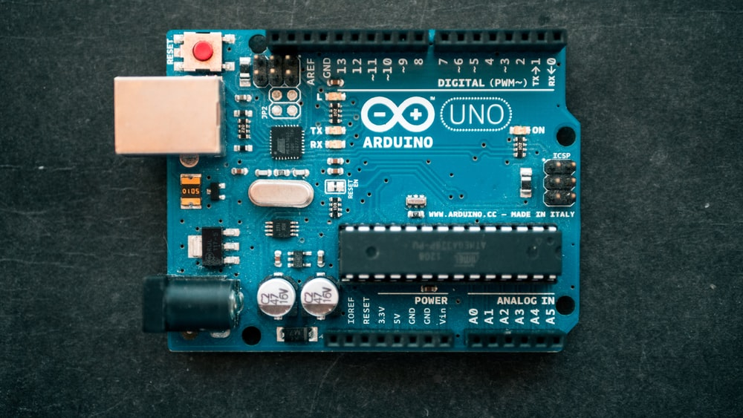
Introduction
The idea of the project is to help the patient’s needs inside a hospital, using Mediapipe, OpenCV and Arduino UNO.
We have taken the idea of hand-tracking using the Mediapipe Library to count the number of fingers to light up the LED's.

Slide 3
Working of the Prototype
Suppose a patient is not in a condition to communicate with the doctor about his/her needs at that moment or needs some supplies but cannot call the doctor. Then the camera monitoring the patient will track the number of fingers put up by him/her.
Accordingly, the light will glow at the place where all the patients are monitored.
We have encoded the count of fingers as :-
1 finger → Green Light → The patient is okay but needs supplies like food and water or some daily medicines
2 fingers → Yellow Light → The patient needs to go to the bathroom for urination or excretion
3 fingers → Red Light → The patient is facing severe problems and needs instant medical attention
Services :
WhatsApp service – Real Time condition of the patient is provided over WhatsApp.
Email service - Real Time condition of the patient is provided over email.

Slide 4
WhatsApp Service Integration
Pywhatkit is a Python library for sending WhatsApp messages at a certain time.
Pywhatkit module utilises the WhatsApp webpage to automate messages sending to any number on WhatsApp. But make sure that you are logged into your WhatsApp in your browser.
Syntax: pywhatkit.sendmsg(“receiver mobile number” , ”message” , hours , minutes)
Parameters:
Receiver mobile number: The Receiver’s mobile number must be in string format and the country code must be mentioned before the mobile number.
Message: Message to be sent (Must be in string format).
Hours: This module follows the 24 hrs time format.
Minutes: Mention minutes of the scheduled time for the message (00-59)

Slide 5
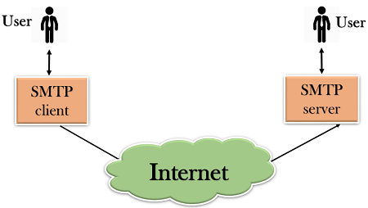
Email Service Integration
Simple Mail Transfer Protocol (SMTP) is a protocol, which handles sending email and routing e-mail between mail servers.
Python provides smtplib module, which defines an SMTP client session object that can be used to send mail to any Internet machine with an SMTP or ESMTP listener daemon.

Slide 6

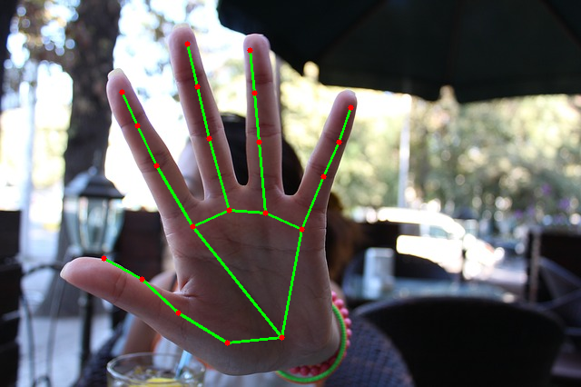
What is Mediapipe?
MediaPipe is a cross-platform framework for building multimodal applied machine learning pipelines. MediaPipe is a framework for building multimodal (eg. video, audio, any time series data), cross platform (i.e Android, iOS, web, edge devices) applied ML pipelines.

Slide 7

What is OpenCV?
OpenCV (Open Source Computer Vision Library) is an open source computer vision and machine learning software library. OpenCV was built to provide a common infrastructure for computer vision applications and to accelerate the use of machine perception in the commercial products.

Slide 8


Softwares Used :
The code of this whole project has been done in Python programming language.
Libraries used in Python :
OpenCV
Mediapipe
Pyfirmata
Controller
Pywhatkit
Date Time
SMTP

Slide 9
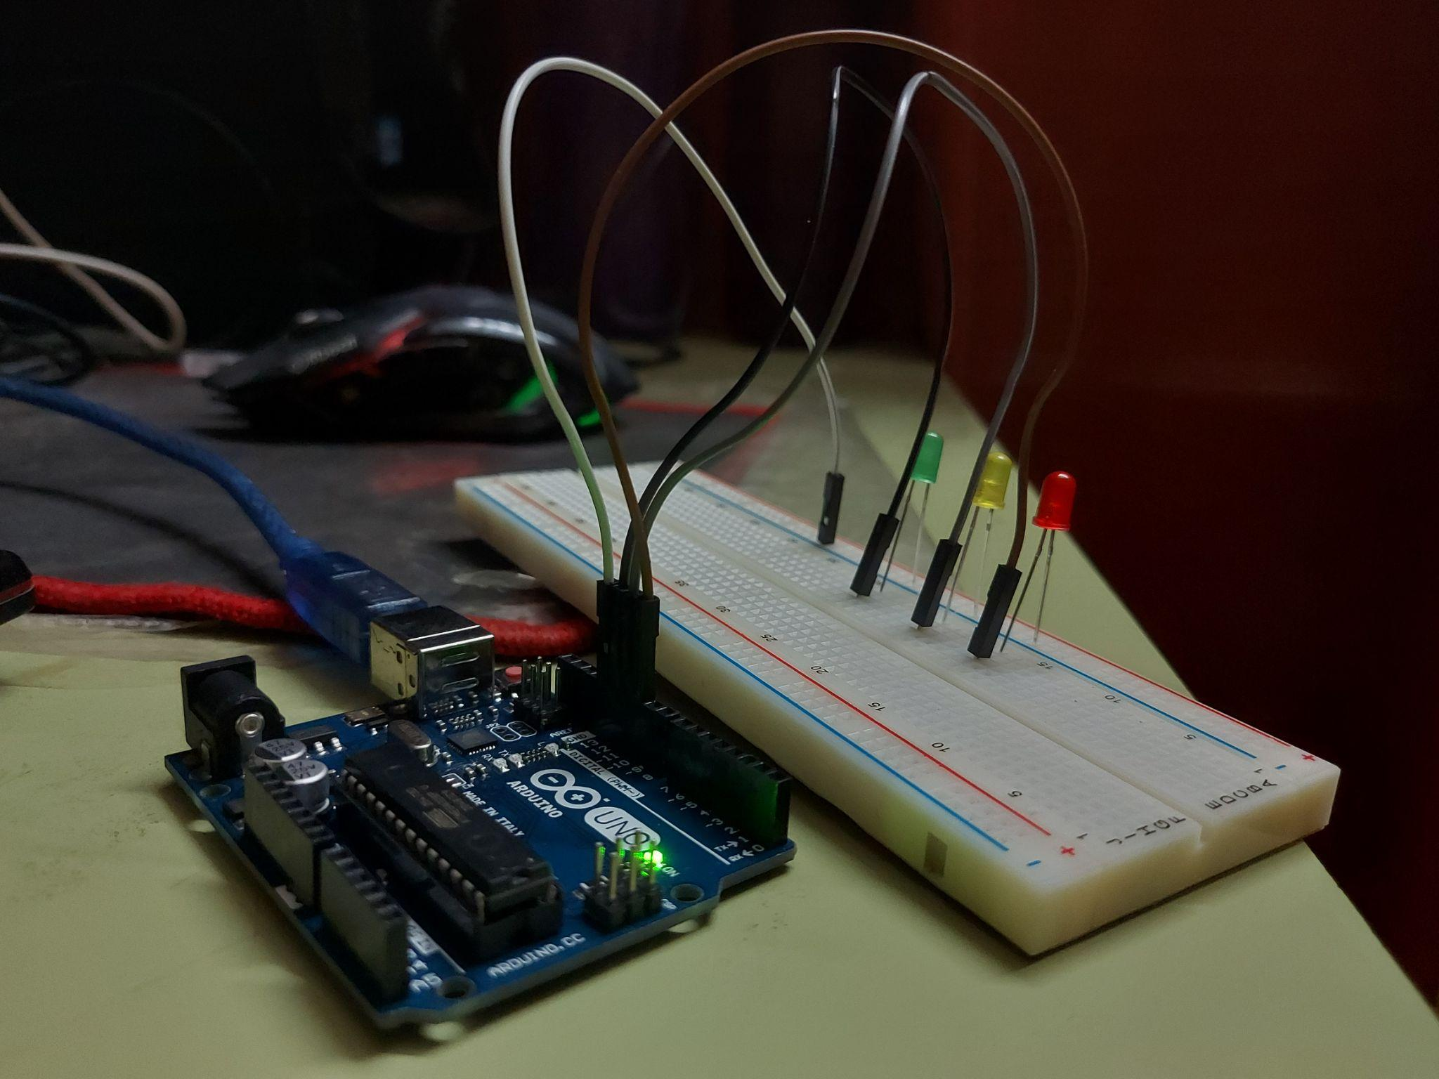
Hardwares Used:
Arduino UNO
Jumper Wires
Breadboard
Camera module (we used our laptops)
LED lights - Red, Green & Yellow

Slide 10

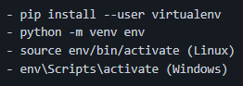
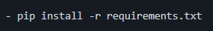
How to set up locally?
Check if your system has python installed in it before!
Fork the repository from this Github Link
Git clone your forked repository
Create virtual environment
Install dependencies
To check all the dependencies run the command :

Slide 11
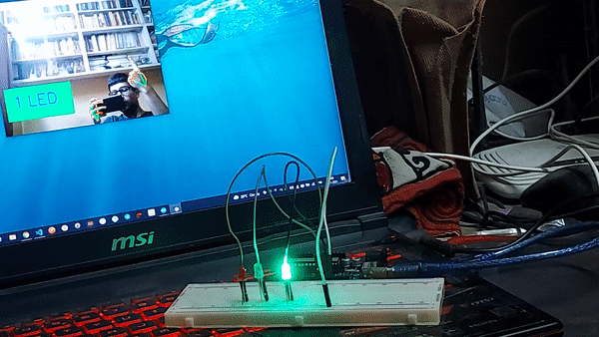
DEMO VIDEO

Slide 12

THANK
YOU

